Slide 1


Beyond Structure-Property Relationships: Correlating Customer Reviews to Consumer Product Formulations
Kaitlin Kay, Adam Luxon, Tyler McQuade, James Ferri
Department of Chemical and Life Science Engineering
Virginia Commonwealth University
December 13, 2019
Notes:
Challenging to get performance data: observed consumer products have written reviews from customers. Test a hypothesis that once can derive performance considerations from customer reviews.

Slide 2



Consumer products
Notes:
Needs more focus…

Slide 3

Performance Data: Structure-Property-Performance
Can complex performance be predicted from molecular components?
What is performance data and where do we get it?
4
3
2
1

Slide 4
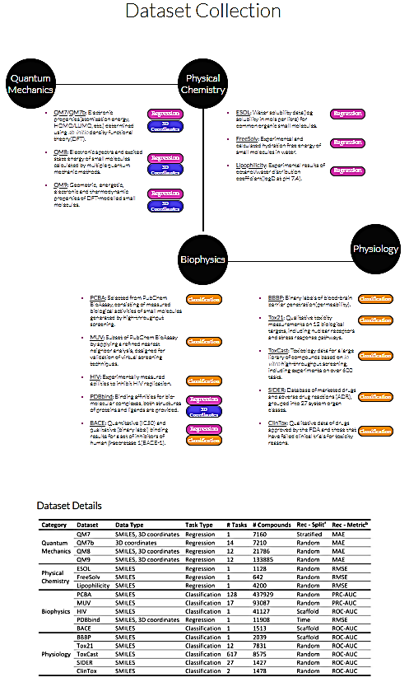
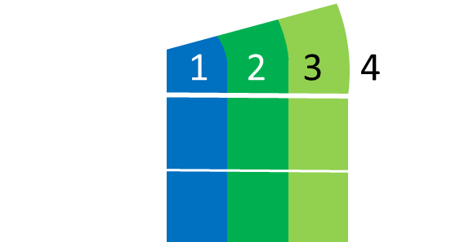
Performance Data: the good, bad, and ugly
Data “Goodness”
clean, validated, precise
Data Format
Example : Log P
Lipophilicity: Experimental results of octanol/water partition coefficient (logP at pH 7.4)
Notes:
This is adam’s data

Slide 5


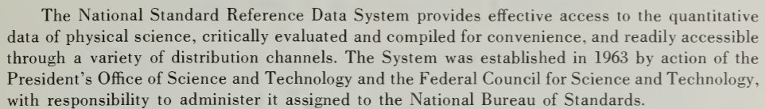
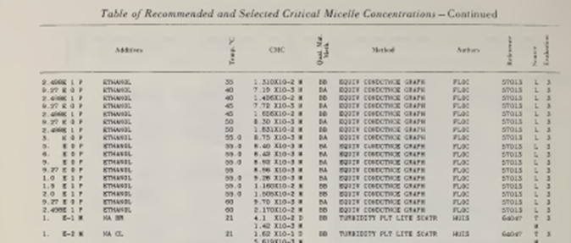
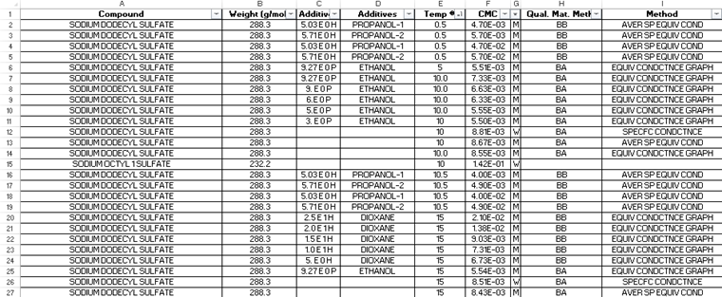
Performance Data: the good, bad, and ugly
Data “Goodness”
clean, validated, precise
Data Format
Example : CMCs of Aqueous Surfactant Systems
Critical Micelle Concentration: Experimental results of surfactant assembly in a variety of solution conditions.

Slide 6

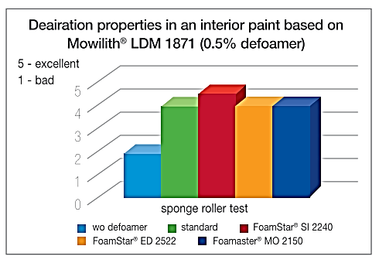
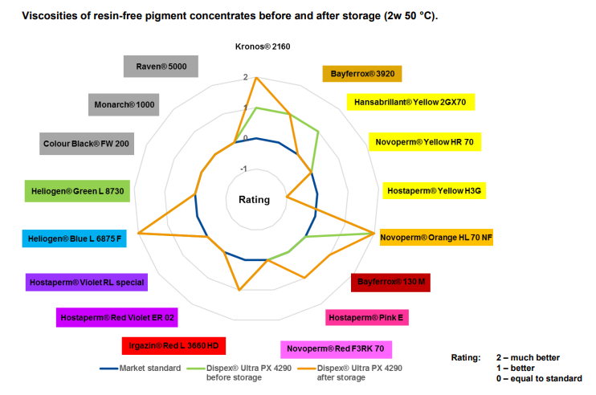
Performance Data: the good, bad, and ugly
Data “Goodness”
clean, validated, precise
Data Format
Example : Manufacturer Technical Datasheets

Slide 7
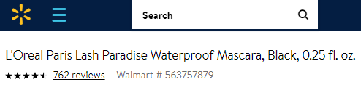
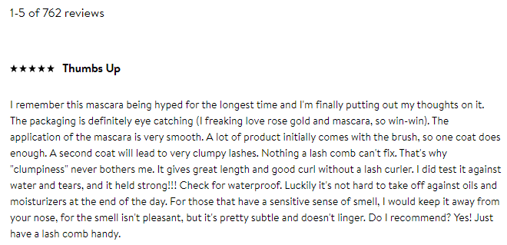
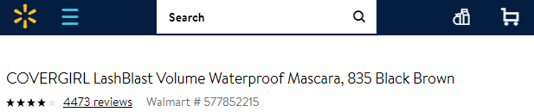
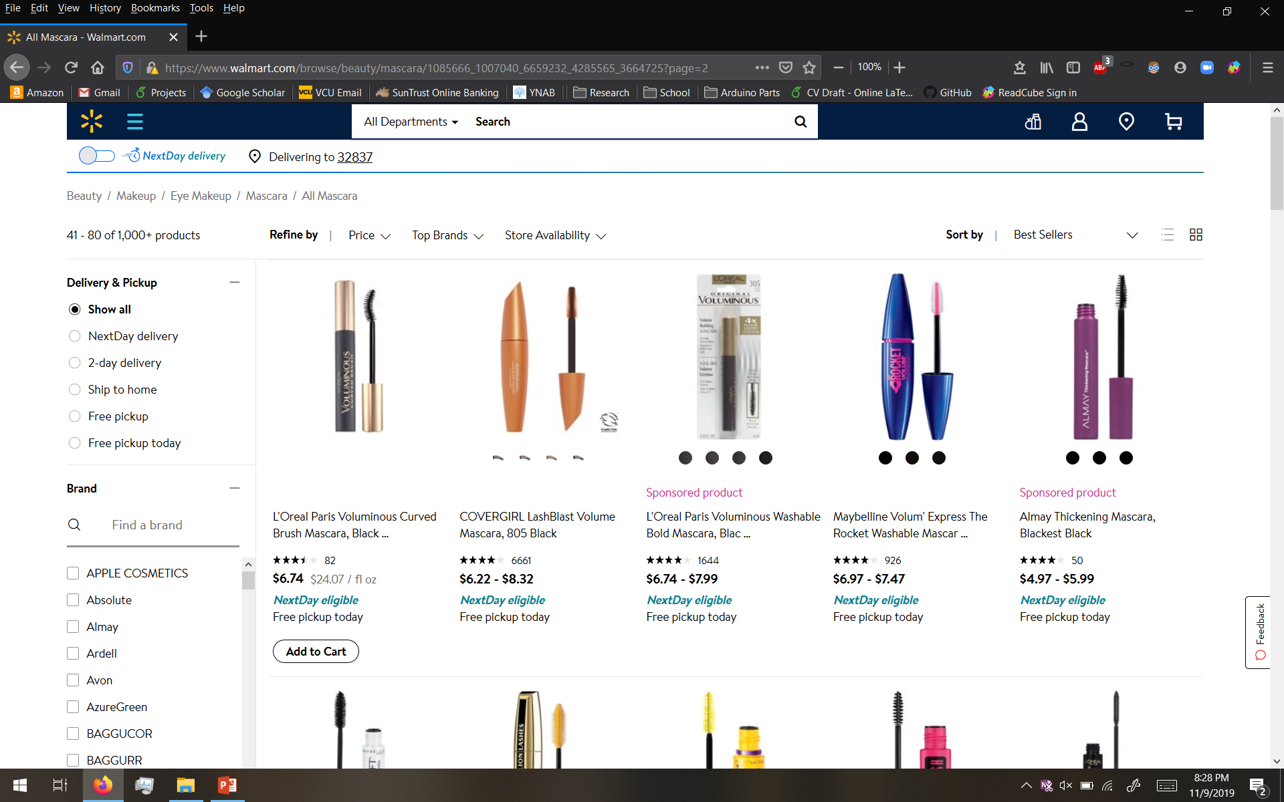
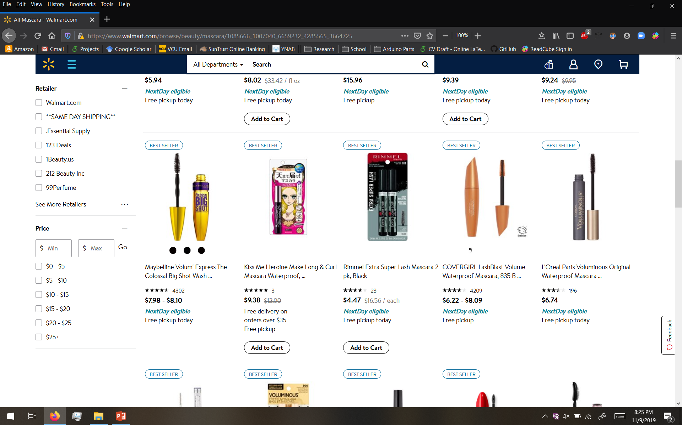
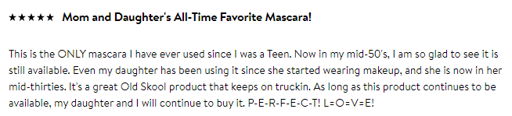
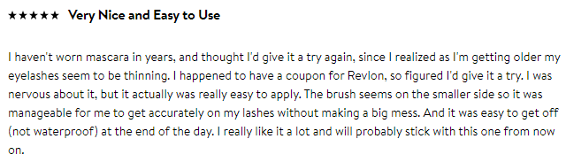
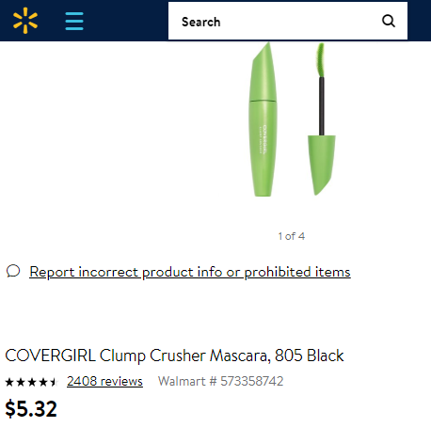
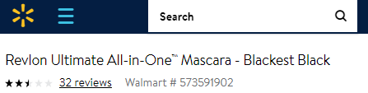
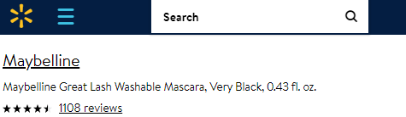
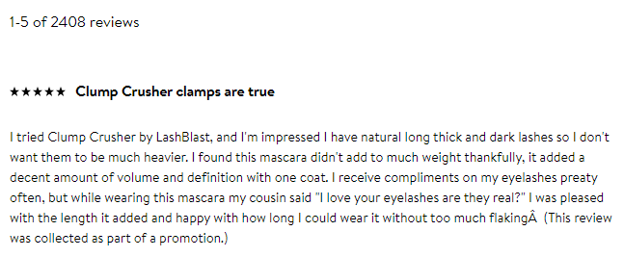

Performance Data: the good, bad, and ugly
Use of consumer product feedback from digital marketplace
Data “Goodness”
clean, validated, precise
Data Format
"Bought this thinking ""It can't hurt to try"" and wow! My dark blonde hair is restored! It was looking mousy brown and dull, one wash with this shampoo and my hair looks mid summer gorgeous. All my natural highlights are radiant and show the full spectrum of blonde. I will be going back to buy the conditioner and some styling products as well. I am so happy that there are products that help my natural blonde hair shine without having to bleach or dye."
Notes:
Thought: add comment layering to drive home the idea that there are a lot of comments and a lot of information to be gained
JKF notes: show the actual website and an example of a product and its reviews

Slide 8
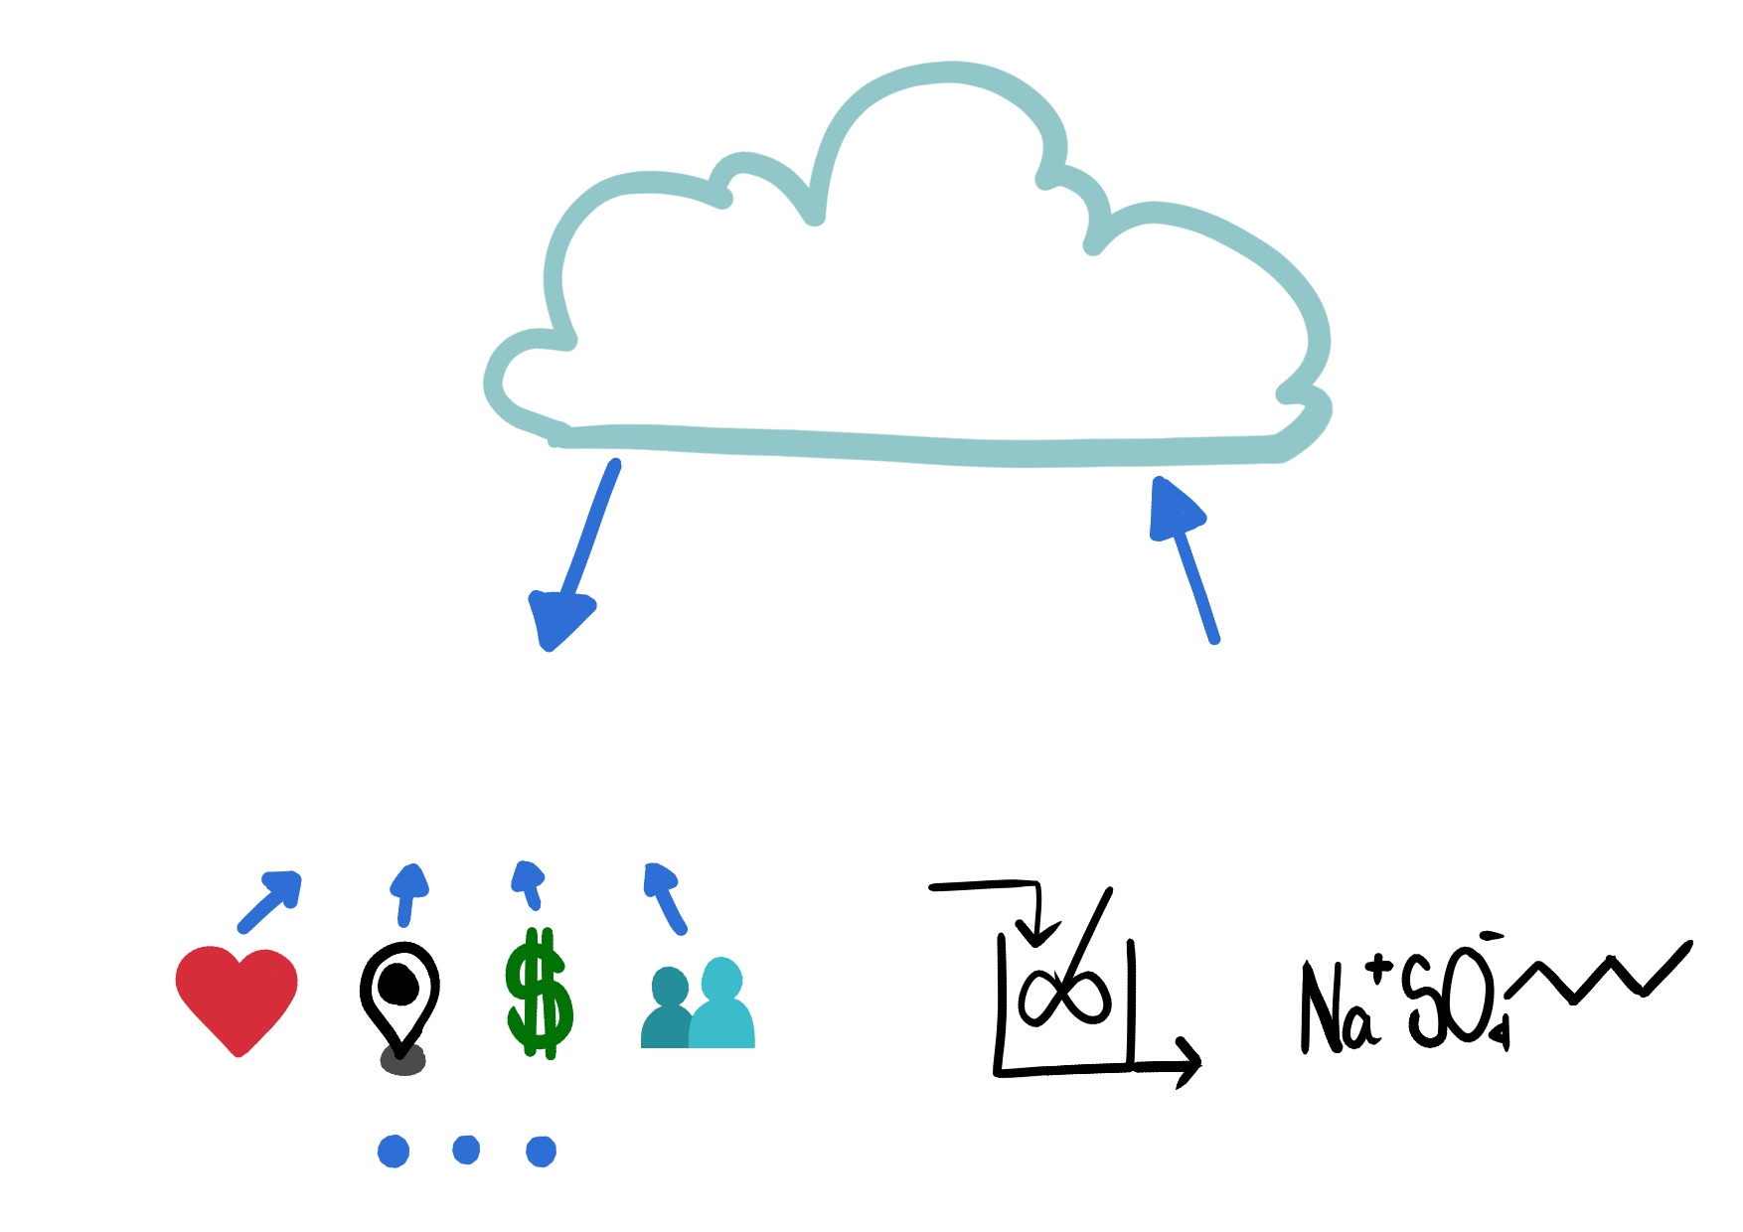
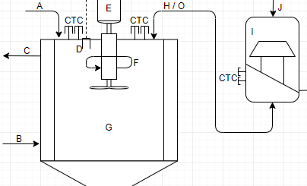
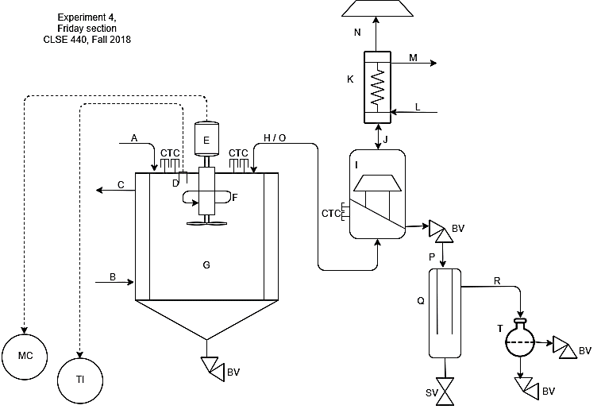
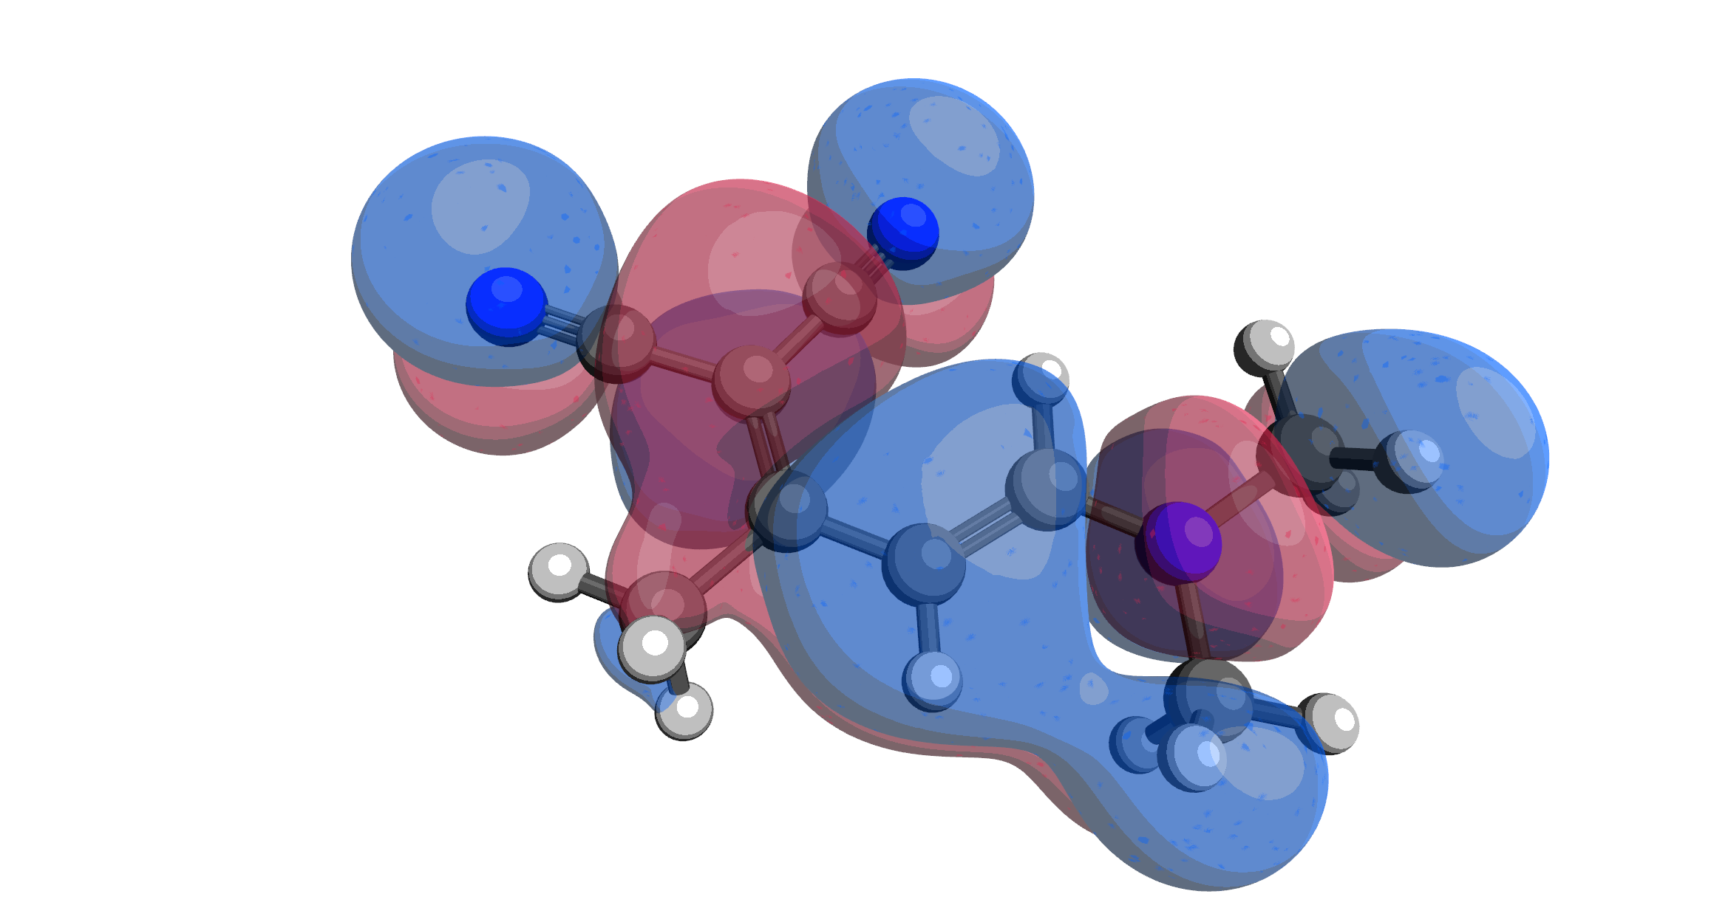


P_{i} = k’(D_{i} , D_{j} , D_{k})
Digital Marketplace
Consumers
Vendors
Consumer Perception (P_{i})
Process(D_{j})
Raw Materials (D_{i})
Influences (D_{k})
$
Notes:
Redo the iconography

Slide 9
P_{i} = k’(D_{i} , D_{j} , D_{k})
Digital Marketplace
Consumers
Vendors
Consumer Perception (P_{i})
Process(D_{j})
Raw Materials (D_{i})
Influences (D_{k})
$
Notes:
Redo the iconography

Slide 10
P_{i} = k’(D_{i} , D_{j} , D_{k})
Digital Marketplace
Consumers
Vendors
Consumer Perception (P_{i})
Process(D_{j})
Raw Materials (D_{i})
Influences (D_{k})
$
Notes:
Redo the iconography

Slide 11
Introduction to the Problem
Question : what is the relationship between consumer perception of product performance and the molecular features arising from the composition of a product?
P_{i} = k’(D_{i}, D_{j}, D_{k→∞} )
P_{i} = k’’’(D_{i})

Slide 12
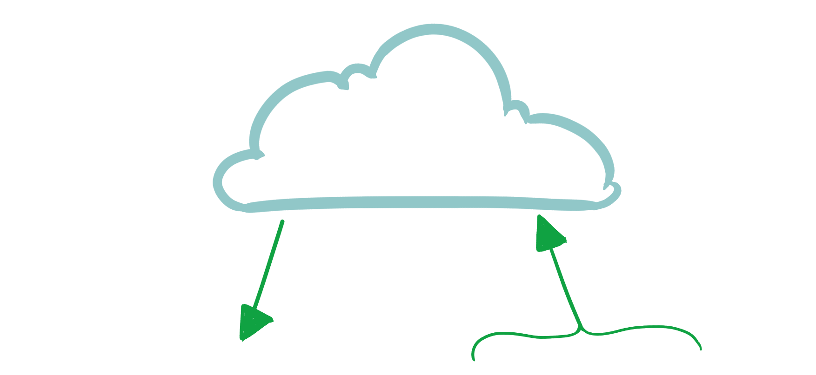
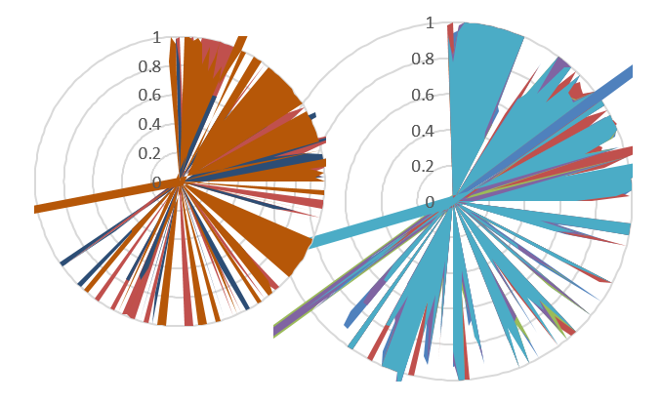
Introduction to the Problem
Example:
Walmart.com
Change to different methods of perception analysis
P_{i}
D_{i}
Word | Frequency
"great" | 3.75
"ok" | 0.6
"horrible" | 3.9
"better" | 1.2
Change to RDkit features
Phrase | Polarity | Subjectivity
“this is great” | 0.8 | 0.75
“this is ok” | 0.5 | 0.5
“this could be better” | 0.5 | 0.5
“this is horrible” | -1 | 1
Notes:
Unquestioned:
“The components of a product directly affect its ability to perform”
But the question is…
How much do these components affect the end products performance?
In what meaningful ways does it affect this?

Slide 13
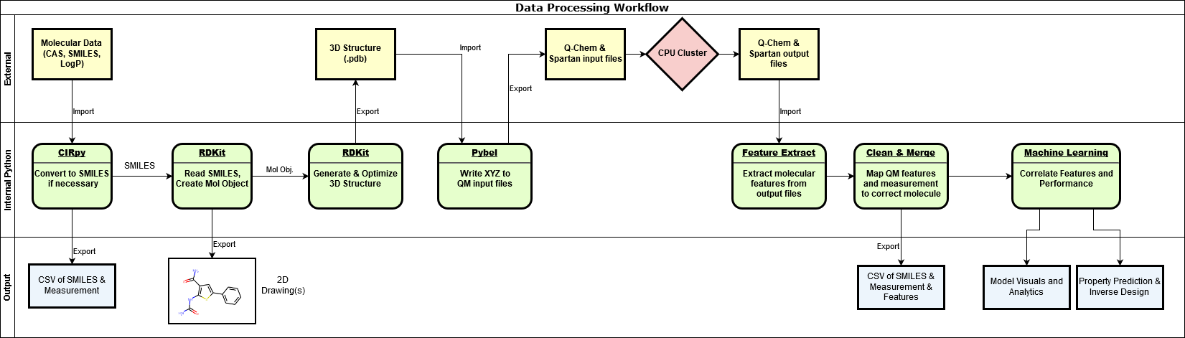
Workflow:
Information Ingestion
Featurization
Visualization
Analysis
Example:
highly curated “ ” data.
Notes:
Continue edits from previous slide

Slide 14
The Flow of Information:
Information Ingestion
Featurization
Visualization
Analysis
Example:
highly curated “ ” data.
Notes:
Step 1:
Can machine learning even tell what a product is based off its product list?
Why is this important?
Different products might have similar ingredients while serving vastly different purposes
If ML can’t see what purpose it serves how can it tell if its doing it well?
Step 2:
If were able to tell what kind of product something is then can we tell if it is performing well?
Use reviews to gauge how well a product performed

Slide 15
The Flow of Information:
Information Ingestion
Featurization
Visualization
Analysis
Example:
highly curated “ ” data.
Notes:
Step 1:
Can machine learning even tell what a product is based off its product list?
Why is this important?
Different products might have similar ingredients while serving vastly different purposes
If ML can’t see what purpose it serves how can it tell if its doing it well?
Step 2:
If were able to tell what kind of product something is then can we tell if it is performing well?
Use reviews to gauge how well a product performed

Slide 16
The Flow of Information:
Information Ingestion
Featurization
Visualization
Analysis
Example:
highly curated “ ” data.
Notes:
Step 1:
Can machine learning even tell what a product is based off its product list?
Why is this important?
Different products might have similar ingredients while serving vastly different purposes
If ML can’t see what purpose it serves how can it tell if its doing it well?
Step 2:
If were able to tell what kind of product something is then can we tell if it is performing well?
Use reviews to gauge how well a product performed

Slide 17
The Flow of Information:
Information Ingestion
Featurization
Visualization
Analysis
Example:
highly curated “ ” data.
Notes:
Step 1:
Can machine learning even tell what a product is based off its product list?
Why is this important?
Different products might have similar ingredients while serving vastly different purposes
If ML can’t see what purpose it serves how can it tell if its doing it well?
Step 2:
If were able to tell what kind of product something is then can we tell if it is performing well?
Use reviews to gauge how well a product performed

Slide 18
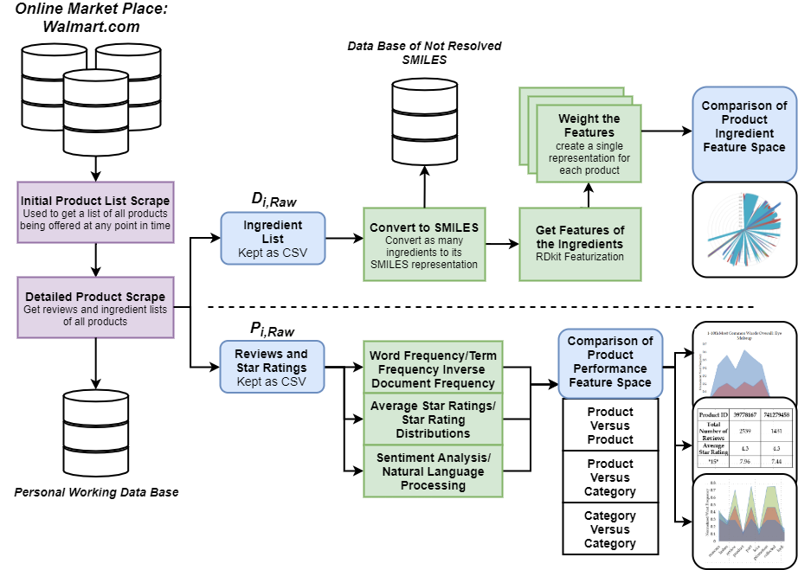
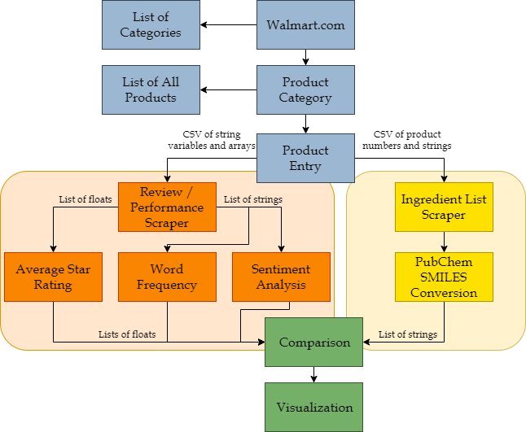
The Flow of Information:
P_{i}
D_{i}
Notes:
What is a SMILES!!!
“change Adam” to something else >>>

Slide 19
Data
P_{i}(product type)
Words indicate product type

Slide 20
Data
P_{i}(product) & Product Type
More reviews increase deviation

Slide 21
Data
P_{i}(product) & Product Type
Highest frequency words unrelated to performance

Slide 22
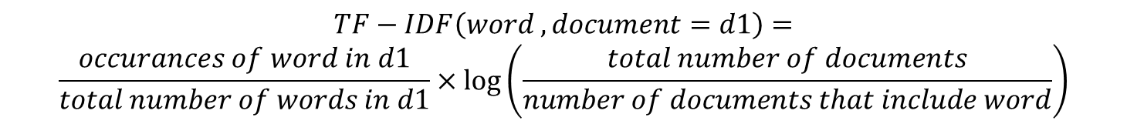
Data
Would top Term Frequency – Inverse Document Frequency (TF-IDF) be better?
$$TF−IDF\left(word , document=d1\right)=$$
$$\frac{occurances of word in d1}{total number of words in d1}×\log\left(\frac{total number of documents}{number of documents that include word}\right)$$
Ranking Method 1 | Ranking Method 2
15 | 15
blew | blew
control | control
five | five
isnt | isnt
streaking | streaking
attractive | removes
chemicals | claimed
clunky | accurate
colored | artist
commented | attempt
Product ID | 39778167 | 741279458 | 545046156 | 537836300
Total Number of Reviews | 2539 | 1431 | 719 | 787
Average Star Rating | 4.3 | 4.3 | 4.2 | 3.3
"15" | 7.96 | 7.44 | 6.61 | 6.75
Again appears to be a function of the total number of reviews, rather than the performance.
Highest frequency words unrelated to performance

Slide 23
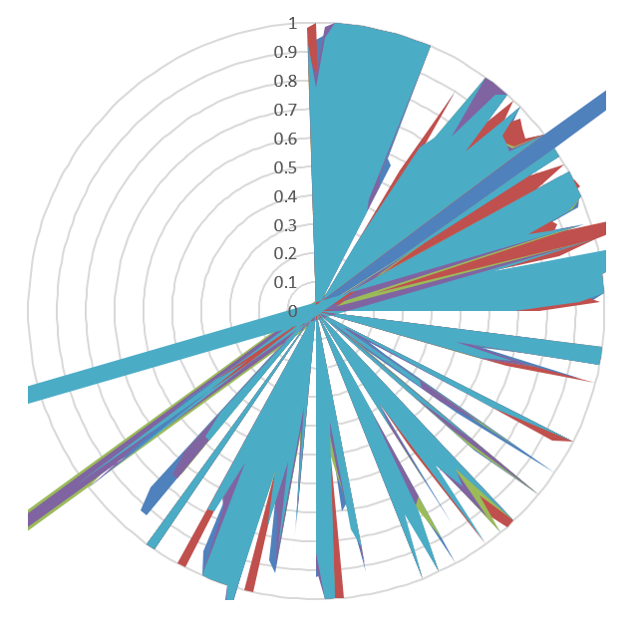
Data
Molecular Featurization:
BalabanJ BertzCT Chi0 Chi0n Chi0v Chi1 Chi1n Chi1v Chi2n Chi2v Chi3n Chi3v Chi4n Chi4v EState_VSA1 EState_VSA10 EState_VSA11 EState_VSA2 EState_VSA3 EState_VSA4 EState_VSA5 EState_VSA6 EState_VSA7 EState_VSA8 EState_VSA9 ExactMolWt FpDensityMorgan1 FpDensityMorgan2 FpDensityMorgan3 FractionCSP3 HallKierAlpha HeavyAtomCount HeavyAtomMolWt Ipc Kappa1 Kappa2 Kappa3 LabuteASA MaxAbsEStateIndex MaxAbsPartialCharge MaxEStateIndex MaxPartialCharge MinAbsEStateIndex MinAbsPartialCharge …
Notes:
Think more about this

Slide 24
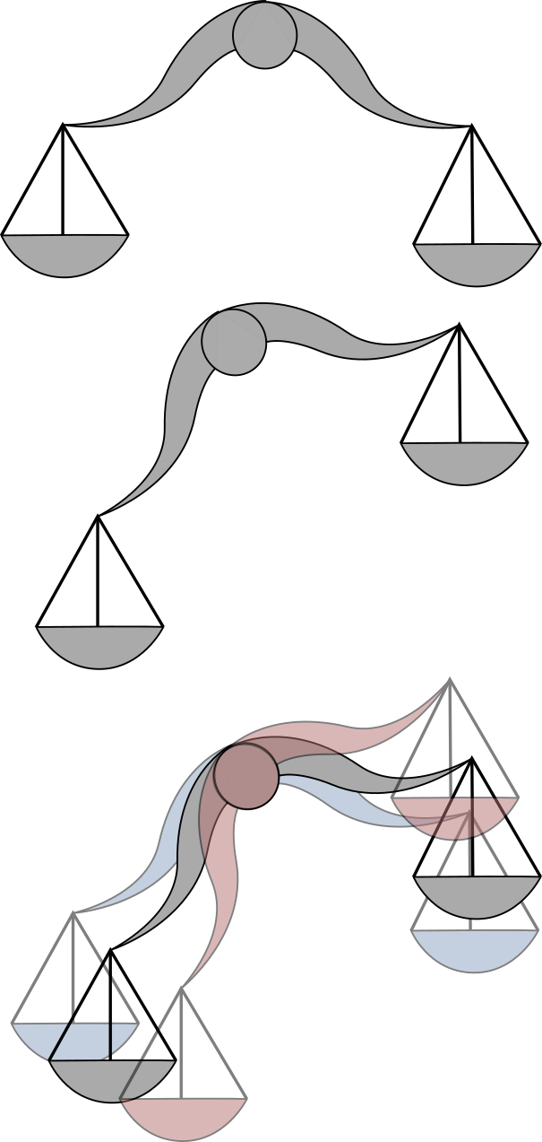
Data
How to handle mixtures?
Ideal
Non-Ideal
Uncertainties in composition
Notes:
Think more about this

Slide 25
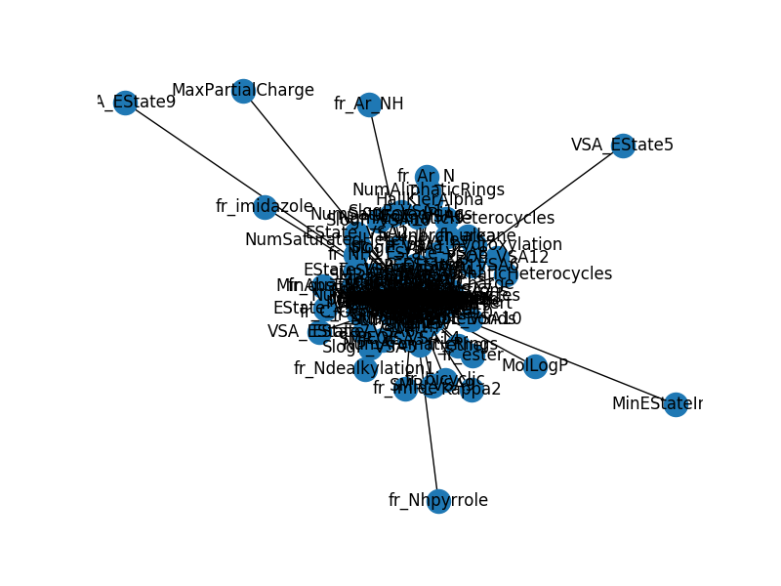
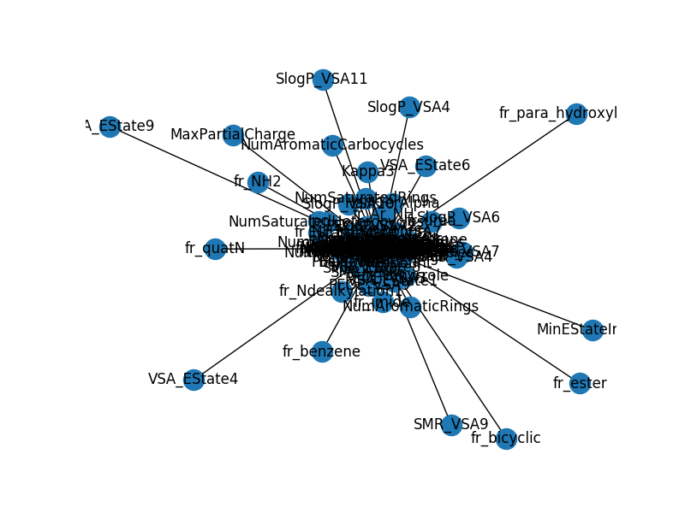
Data
Product 1
Product 2
Notes:
Expand to more graphs
Remove labels
Etc. etc.

Slide 26
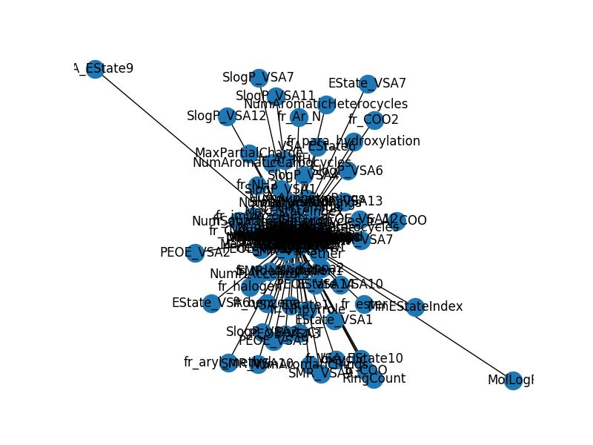
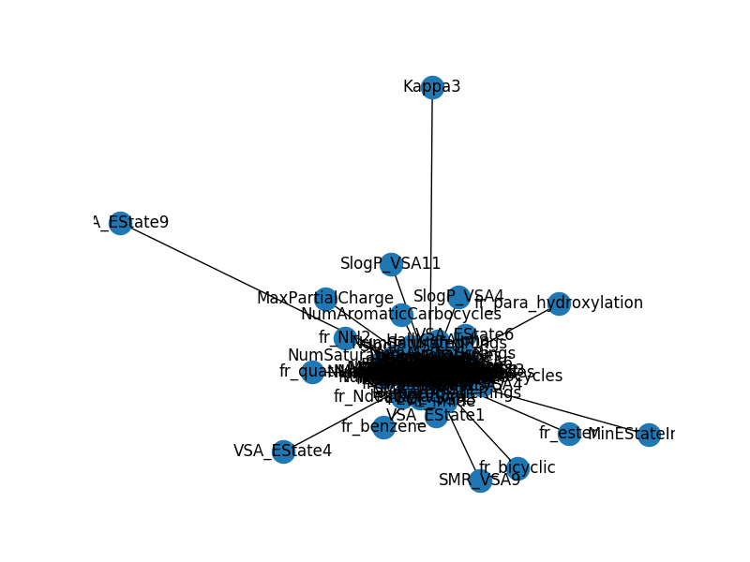
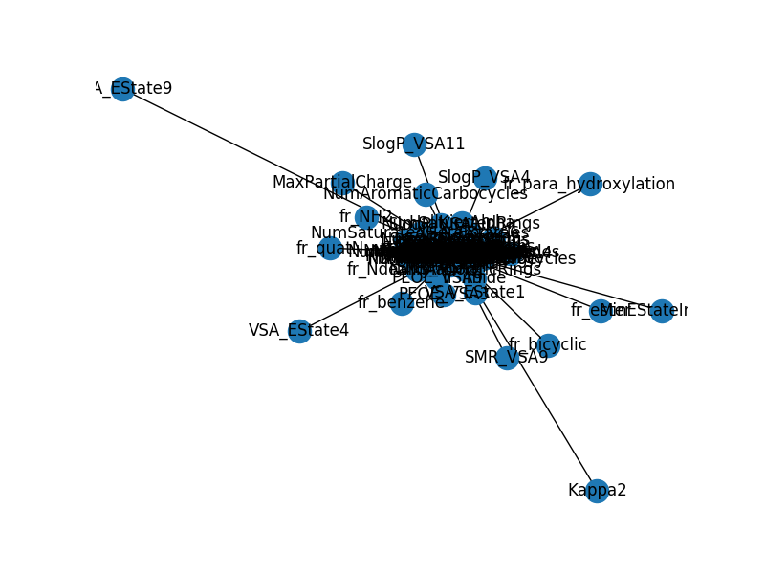
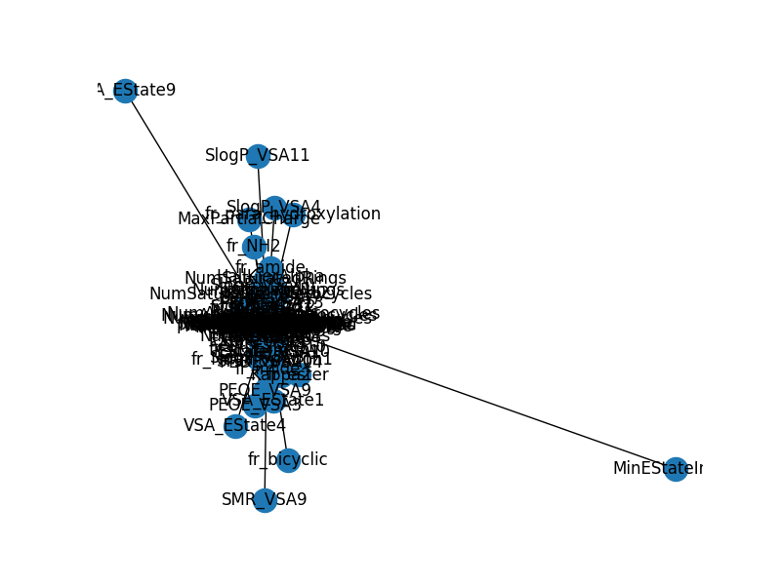
Data
Unweighted
Weighting 1
Weighting 2
Weighting 3
Weighting 4

Slide 27
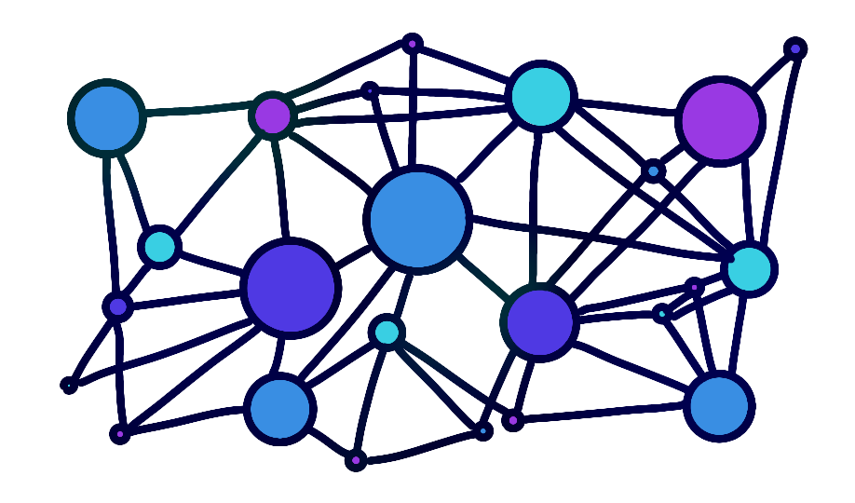
Summary
Digital marketplaces can provide real-time direct consumer product performance
Challenges in featurization and mixing rules
Notes:
Hope to make models: k’ like ML

